Slide 1

CETIN POC

Slide 2
Use Cases FNT
CETIN CZ POC
UC 1: Network infrastructure documentation (CORE, IP, Transport)
TBD
UC 2: Access network documentation
TBD
UC 3.2: Semi-automatic and manual check
UC 4: Service decomposition (GUI)
UC 5: NI Specific Functionalities (Mass Configuration Changes)

Slide 3
Wipro – UC 6: Service availability check
CETIN CZ POC
Preconditions:
Existing POP-Sites (OLT, DSLAM and 5G) with geo-coordinates in FNT Command
Input parameters:
New customer site with geo-coordinates
Search radius
Procedure:
Search POPs within radius (Math formula)
For each found POP query related NE (OLT, DSLAM)
For each NE query rest uplink bandwidth
Output:
List available of POPs
For each POP – available technology and rest bandwidth

Slide 4
Wipro – UC 3: Provisioning of customer services – UC3.1 Automatic check
CETIN CZ POC
Preconditions:
UC6: Service availability check is implemented
Input parameters:
Address (Zone – Campus/Building/Floor/Room)
ONT Type (FNT Component)
Service Type Definition (e.g. 125Mbps)
OLT Name
Procedure:
Activate planning protocol
Create ONT at the address
Create Logical Port on the OLT
Create Bearer OLT-ONT
Routing of Service ONT-OLT-Backbone (automatic determination of the route)
Deactivate planning protocol
Output:
Planning protocol in FNT Command
Post-processing:
Set PLAN to AS-IS

Slide 5
Wipro – UC 4: Service decomposition
CETIN CZ POC
Preconditions:
Existing GPON services in FNT Command
Input parameters:
Node
Cable
…
Procedure:
Query Telco hierarchy for given input
Highlight end customer services (S), infrastructure services (I) and neighboring nodes (N)
Output:
List of impacted services (S),(I),(N)

Slide 6
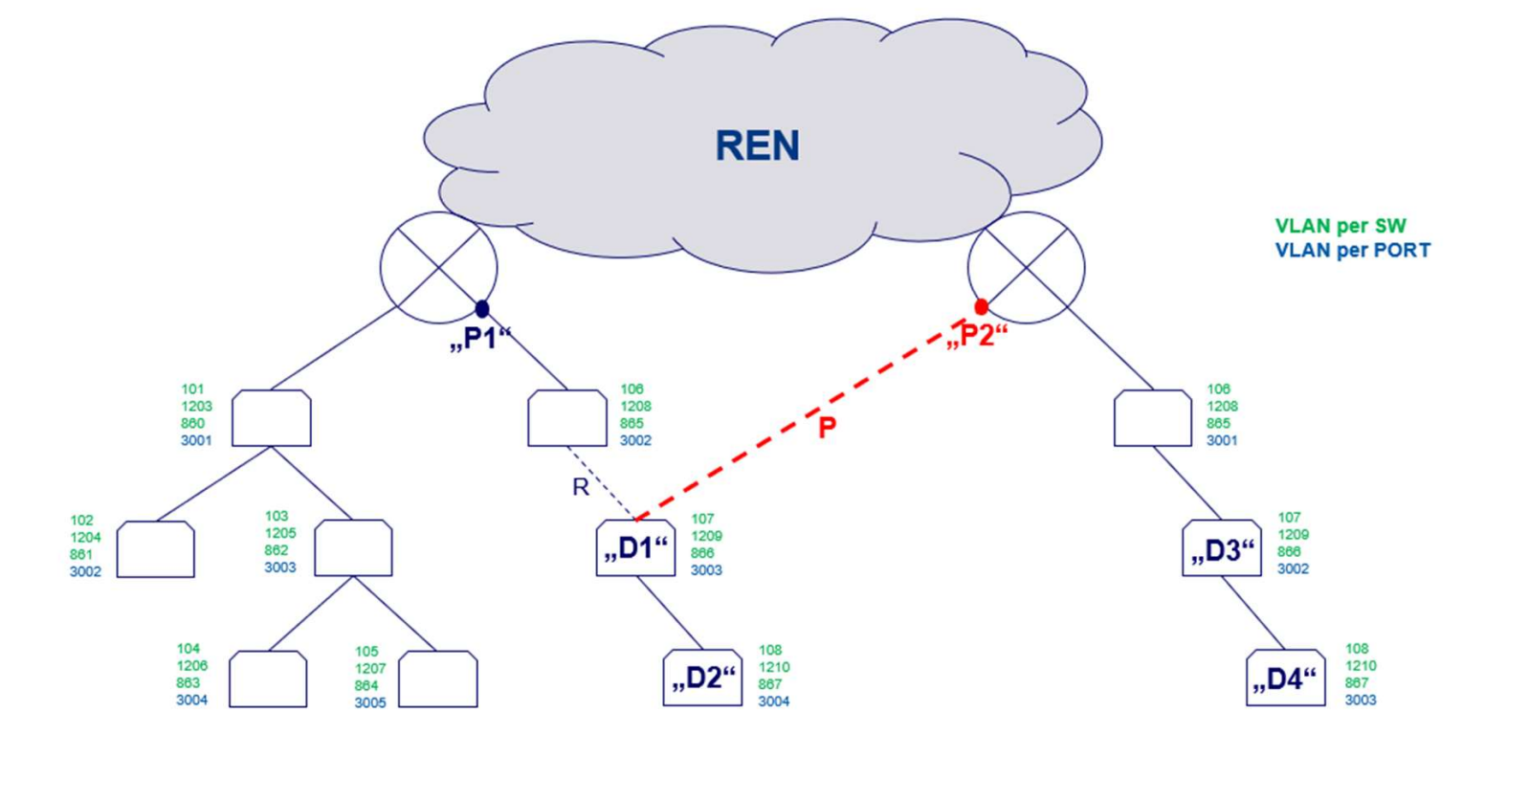





















UC 5: NI Specific Functionalities (Mass Configuration Changes)
CETIN CZ POC

